Slide 1
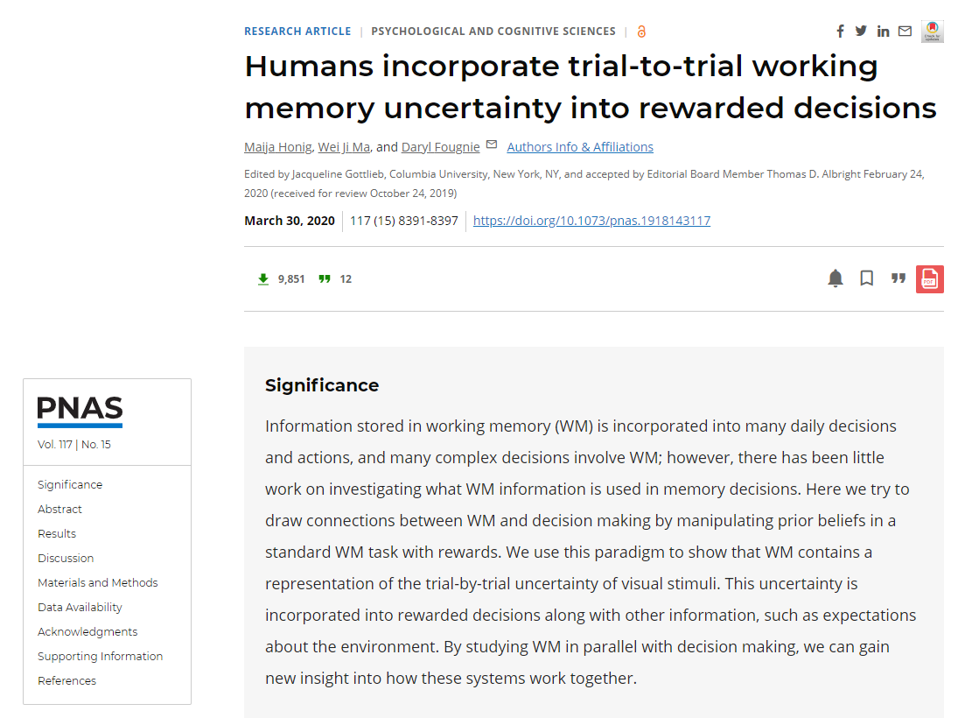
汇报人：应鹏星

Slide 2
Introduction
Working memory (WM), the storage and manipulation of information on a short timescale, is essential for many cognitive processes.
such memory paradigms as delayed estimation
However
WM information is used not only to make estimates of stimuli features, but also to make decisions and take actions.
e.g. when to cross the street.
However
Uncertainty in WM is rarely studied.
e.g. people know their uncertainty on a trial-to-trial level; when people make explicit reports of confidence in memory decisions, the amount of response error correlates with the reported confidence on each trial.
However
Confidence ratings are not necessarily a reflection of memory uncertainty, and may be produced through a different mechanism from those used to make decisions under uncertainty.
Integrating such WM uncertainty information into decisions would be highly adaptive.

Slide 3
Participants
Twelve individuals (seven females; mean age, 21.75 y; range, 19 to 28 y) participated in four 40- to 60-min sessions of this experiment.

Slide 4
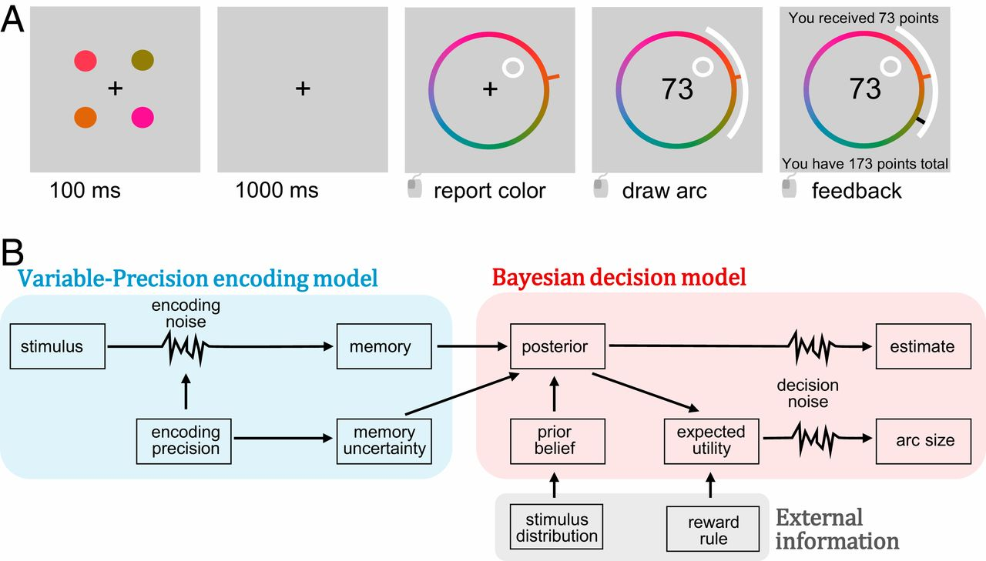
Trial Procedure
Rewarded Decision
Uniform Stimulus Distribution
support
points = (180 − A)/A
Or
points = 0
Von Mises Stimulus Distribution
Performance Incentivization
achieving 18,000 points
&
bonuses based on the summed points from three random trials

Slide 5
Model
v
̂s
s
κ
κ*
x
A
μ
κw
risk attitude, α
inverse temperature, β
have no information, λ

Slide 6
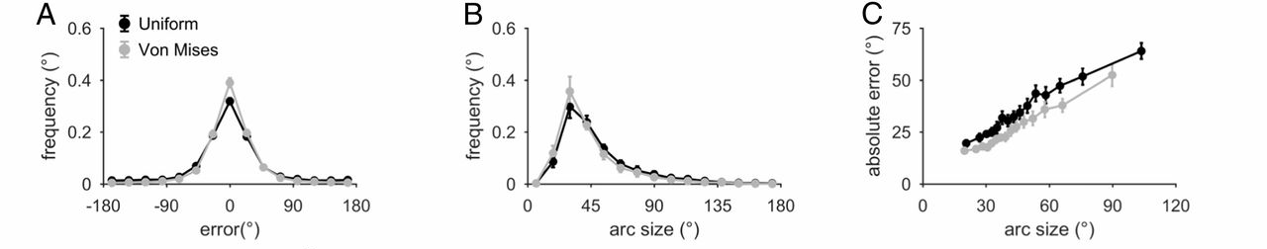
Results-Uniform Stimulus Distribution
r_{s} = 0.31 ± 0.029
the circular distance between stimulus and estimate, in degrees
riskier decisions (smaller arcs) were associated with smaller errors and vice versa.
people know their trial-to-trial memory quality, consistent with the idea that WM represents memory uncertainty.

Slide 7
Results-Uniform Stimulus Distribution
However
accurate reports of memory quality do not necessarily imply that this uncertainty is stored in WM.
One possibility: people use information about stimulus features as a proxy for uncertainty.
e.g. stimulus color.
如果观察者知道他们对粉色的编码很差，就可以在粉色刺激的试验中设置更大的弧线

Slide 8
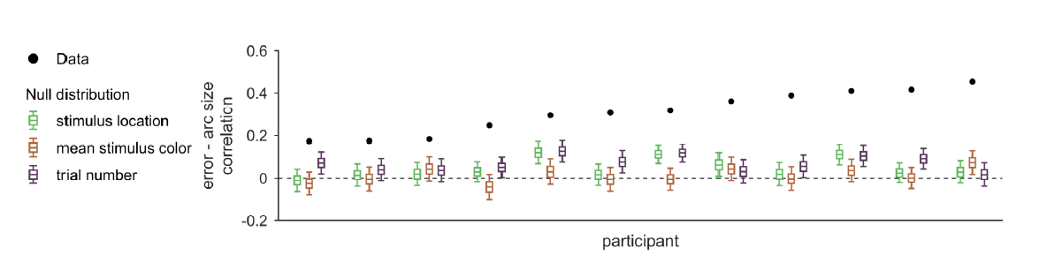
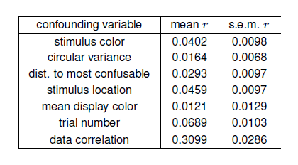
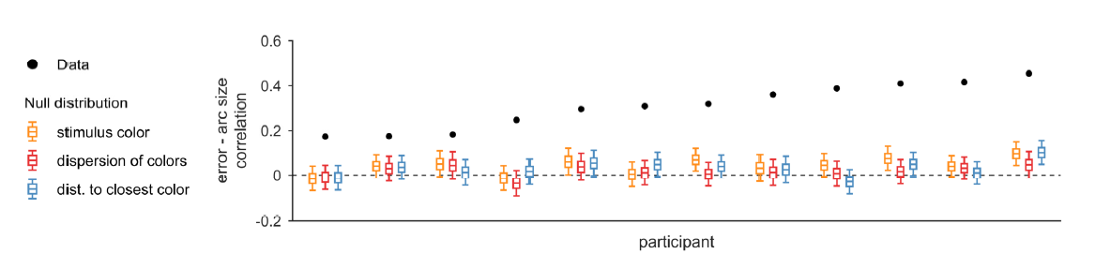
Results-Uniform Stimulus Distribution
All confounding factors predicted much lower correlations than those observed.
there is sizeable uncertainty due to internal processes, and that participants’ knowledge of memory quality is not explained by remembering stimulus properties.

Slide 9
Results-Uniform Stimulus Distribution
However
accurate reports of memory quality do not necessarily imply that this uncertainty is stored in WM.
Another possibility: an observer’s limited knowledge of their uncertainty.
For instance, even if there were no internal representation of uncertainty, an observer could know something about their memory quality simply by being aware of “lapse trials” in which they had low precision (e.g., blinking during stimulus presentation).
观察者知道他们没有对刺激进行编码
know or not know?

Slide 10
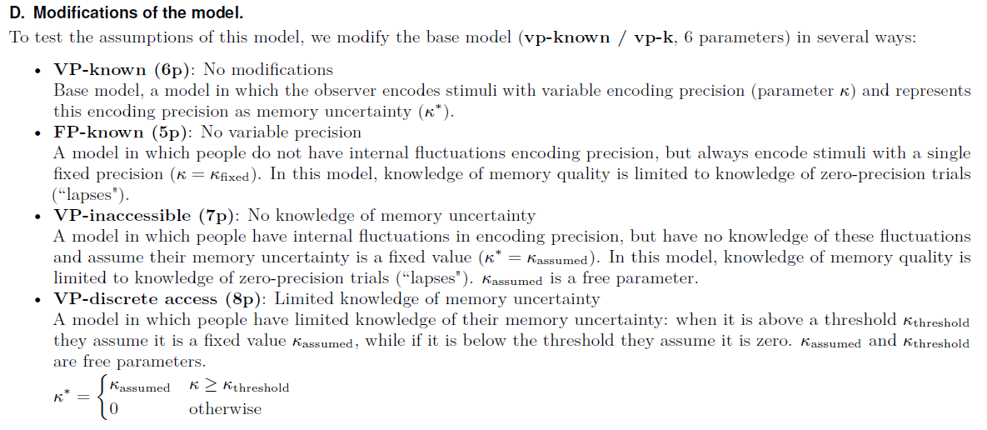
Results-Uniform Stimulus Distribution

Slide 11
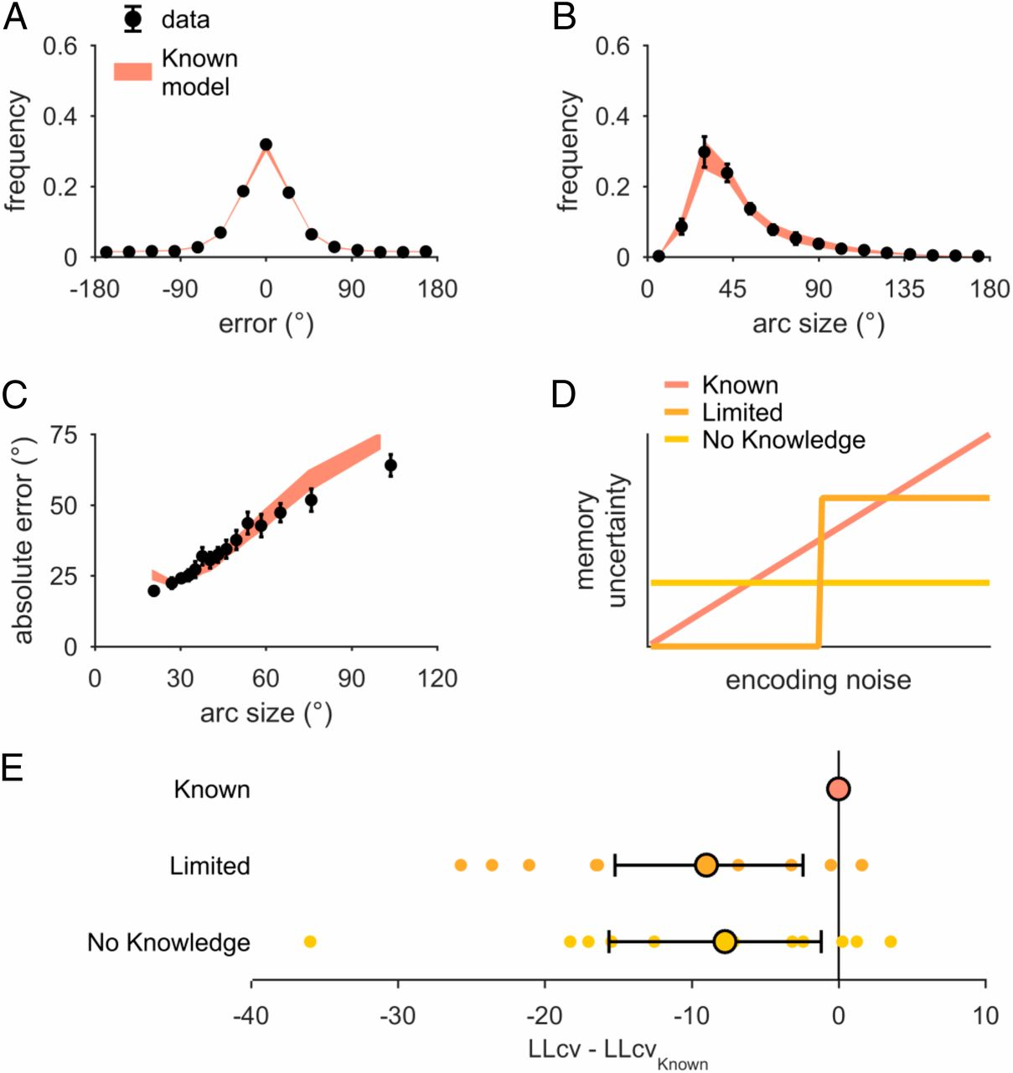
Results-Uniform Stimulus Distribution
VP-known (6p): No modifications
Vs.
FP-known (5p): No variable precision
encoding precision is variable
models without knowledge of encoding noise perform poorly, suggesting WM uncertainty as a causal factor of both estimation errors and arc responses.

Slide 12
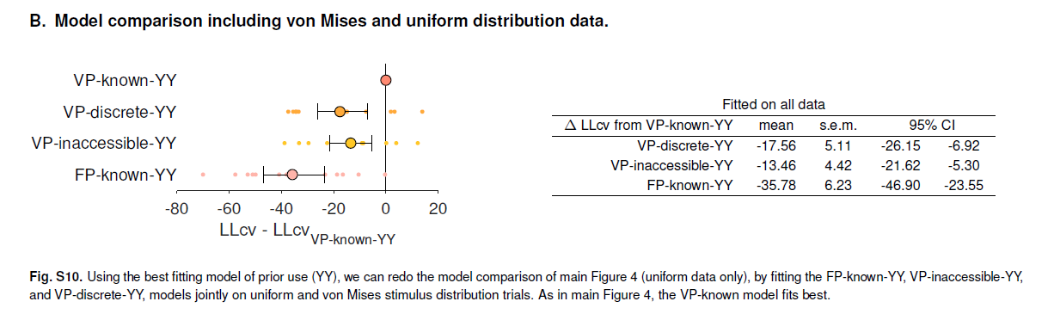
Results-Von Mises Stimulus Distribution
Go ahead
To test whether people could combine their WM uncertainty with prior information.
two of the four experimental distributions to be a von Mises (circular normal) distribution.
Participants were trained to learn the stimulus distribution, inducing prior beliefs about stimuli.

Slide 13
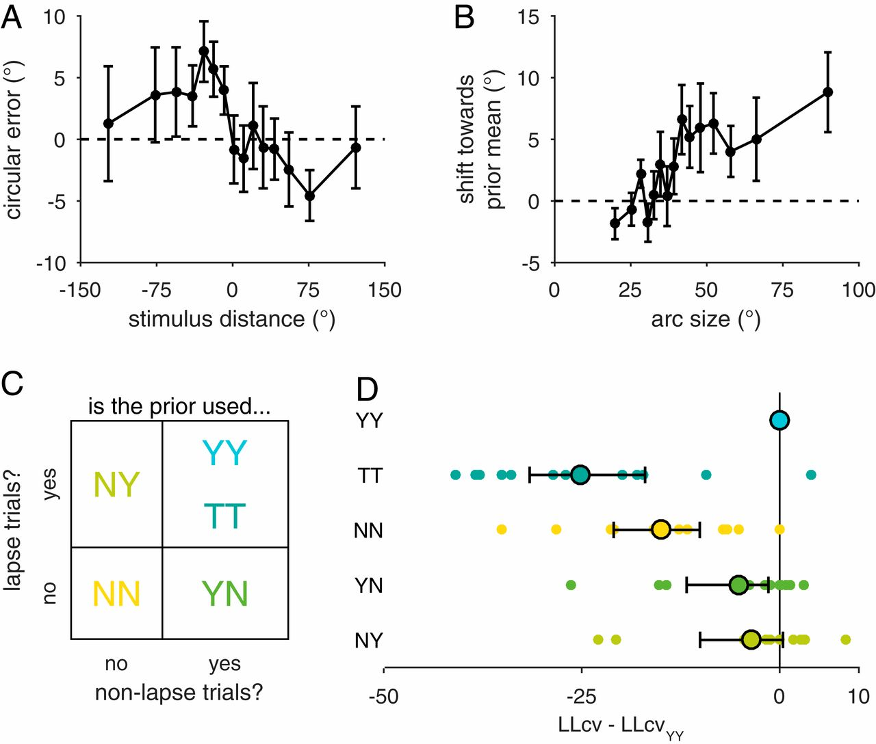
Results-Von Mises Stimulus Distribution
To validate
responses incorporating prior information should be attracted toward the most frequent color?
r_{s} = 0.080 ± 0.025
responses on the left (−) of the most frequent color (0) have rightward error (+) and vice versa.
1. the amount of shift toward the prior mean is correlated with arc size.
quantify this by multiplying the error by the sign of the stimulus on that trial to obtain the directional shift toward (+) or away from (−) the prior.
2. the correlation of response error with the prior error
confounding factors
people incorporate prior and memory information in proportion to their memory uncertainty.
The mean shift toward the prior is positive, showing that stimulus estimates are attracted to the prior mean.

Slide 14
Results-Von Mises Stimulus Distribution
To understand
how prior and memory information are incorporated?
An optimal observer: WM + prior information
whether prior information is used in nonlapse trials (“Y” for yes, “N” for no)
whether prior information is used in lapse trials (“Y” for yes, “N” for no)
participant responses incorporate prior information.
2
1

Slide 15
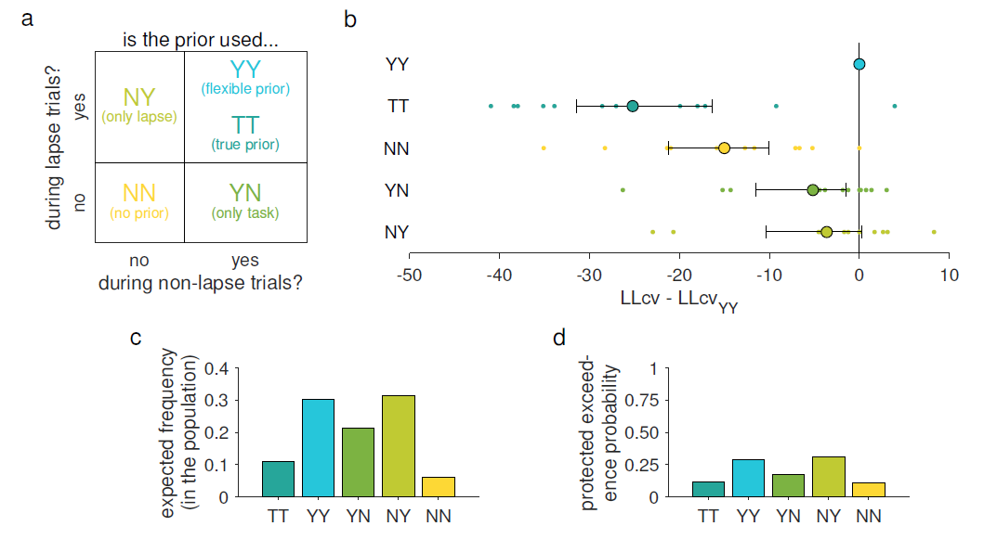
Results-Von Mises Stimulus Distribution
To understand
individual differences?

Slide 16
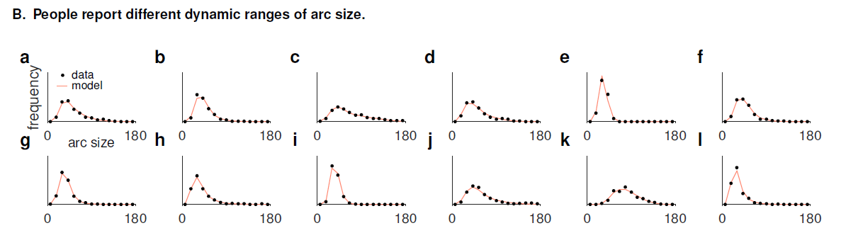
Results-Von Mises Stimulus Distribution
To understand
individual differences?

Slide 17
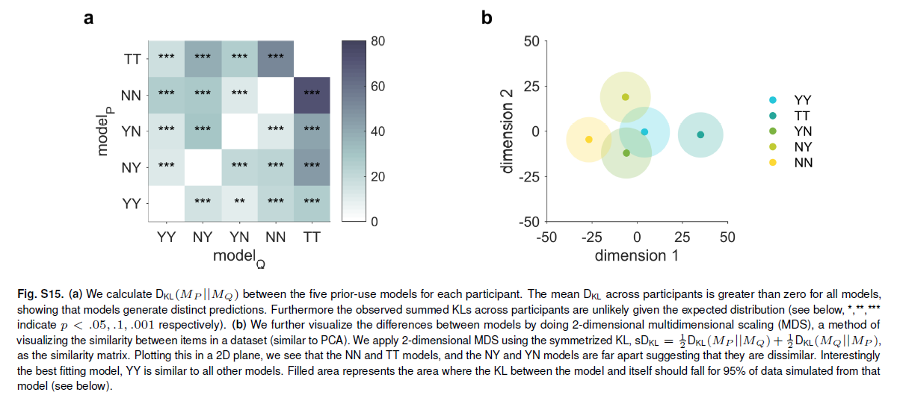
Results-Von Mises Stimulus Distribution
To understand
individual differences?
models generate different predictions for participant behavior using model recovery analyses
people may have different strategies of combining prior and memory information.

Slide 18
Discussion
People can accurately report the quality of their own memories and incorporate stimulus reliability into memory decisions.
People’s knowledge of memory quality cannot be explained by stimulus display factors or limited knowledge of encoding precision, suggesting that WM represents memory uncertainty.

Slide 19
Discussion
When provided with prior information about stimuli probabilities, the data are best described by models in which this information is combined with WM uncertainty, showing that WM uncertainty can be combined with other sources of information.
Overall, the data are best described by a hierarchical model in which different people use different strategies of prior and memory uncertainty combination. This suggests that people are capable of combining prior information with memory uncertainty, although not all individuals may do so.

Slide 20
Discussion
While we present evidence that WM contains a representation of memory uncertainty that can be combined with other sources of information, how this is implemented in the brain remains an open question.
there are many ways in which probabilistic information could be represented in WM.

